Slide 1

What a Board wants
What a Board Member needs and should expect
Presented by FarWell Project Advisors LLC
Catie McDonald
FarWell™️ Senior Advisor

Slide 2
Board Members are not actually getting what they need and therefore cannot provide what you want.

Slide 3
Generic Board Member Profile
Member of their Credit Union
Wants to serve on a Board, probably has previous board experience
Active in Community
Could be a resume builder or retirement activity

Slide 4
BUT – Do they know Credit Unions?
Notes:
- My experience is that they really don’t. And by not knowing what makes credit unions special and unique. By not knowing what the key issues are facing credit unions and the credit union system – they are not prepared to make the decisions they need to make as a member of your board.
- I live in Madison WI – the most credit union town there is – and most people don’t know what makes CUs special
- So let’s discuss a few things that a board member really wants so that they can be the best board member they can be and therefore help your CU perform better
- Specifically, I think this is very important to discuss with Board Chairs. You’ve probably been there a while – some of this may seem obvious to you. But for newer members, it can be a big learning curve, there are probably a lot of assumptions – if IF it is ever addressed or if they learn it by osmosis. As a board chair, you have an opportunity to train and onboard and recruit in a different way than the CEO and these are some topics that can complement the CEOs training.

Slide 5
1. KNOW YOUR WHY; KNOW YOUR ORIGIN STORY

Slide 6
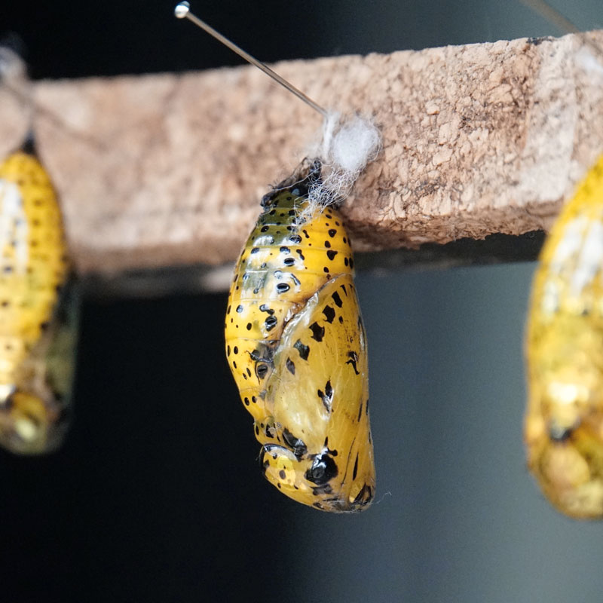
Origin Story
Why does your credit union exist? Why was it created? How does that connect to why your credit union exists now?
WHAT A BOARD WANTS
| FarWell™
| 6

Slide 7
2. KNOW YOUR MEMBERSHIP

Slide 8

Who do you serve and how are you serving them? What does your target audience look like? What are your demographics and how are they changing? How are your members needs changing?
Your Members
WHAT A BOARD WANTS
| FarWell™
| 8

Slide 9
3. Know Why Credit Unions are Different

Slide 10

What does it mean to be part of a Movement? What are all these acronyms - NCUA, NCUF, CUES, WOCCU, CFPB… Where can the find the resources available to them? How can they stay on top of National trends and what they means to your credit union?
Industry insights
WHAT A BOARD WANTS
| FarWell™
| 10

Slide 11
4. Know how your Credit Union is organized
and plan for succession

Slide 12

Who reports to the CEO and why? What roles can you expect to see at Board Meetings and why are they there? Who is in charge of succession planning and what is the plan? How is the CEO and the senior leadership team reviewed and what your role is in that review
Your role as a leader
WHAT A BOARD WANTS
| FarWell™
| 12

Slide 13
5. Know your rights and responsibilities

Slide 14

What are the written and unwritten rules? How should I interact with the credit union outside of Board Meetings? What should I know about meetings outside the meeting? How do I best champion and cheerlead?
Rights and responsibilities
WHAT A BOARD WANTS
| FarWell™
| 14

Slide 15

What a Board Wants
Five Key areas for a Productive Board
#1
Origin Story
#2 Membership
#3
Credit Unions
#4
Organization
#5
Your Rights
What is your CU’s history? How does that inform their why?
Who do you serve? What do they need? How is this changing?
What does it mean to be part of a Movement?
How is the CU organized? What is the succession plan?
What are your expectations – written and unwritten?
Notes:
- What this also leads to is Board Culture – working towards a clear vision, a reason to do the work

