Slide 2
Succession: Building the Bench for Future Growth and Relevance Facilitated by: Scott Butterfield

Slide 3
The State of Succession

Slide 4
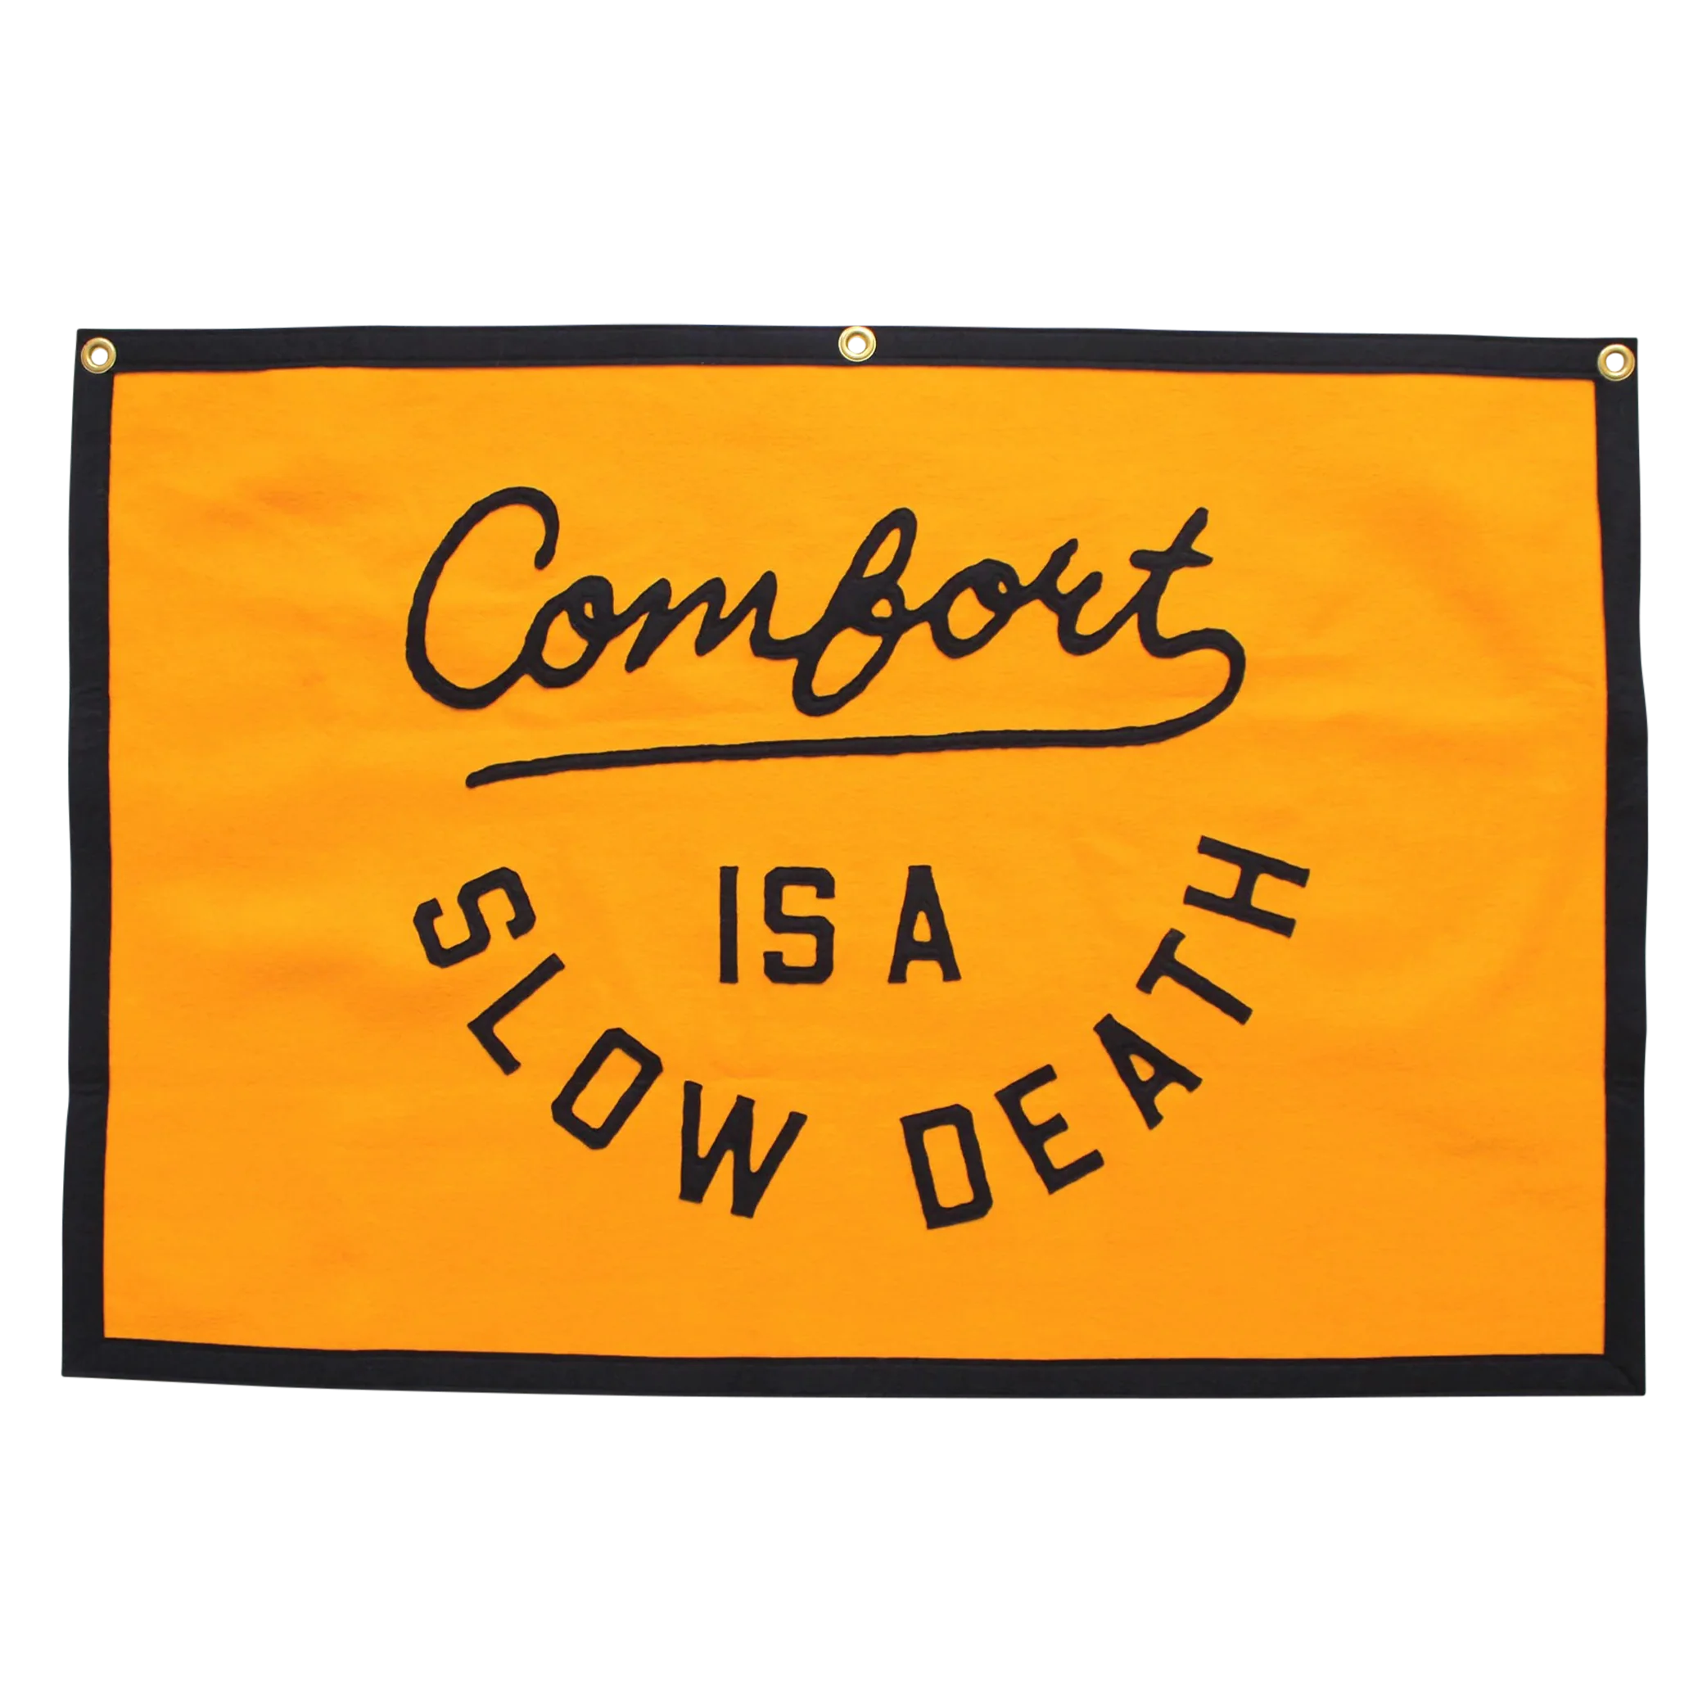
Plan Now, or Merge Later
A 2022 NCUA analysis shows “poor management succession planning was either a primary or secondary reason for almost a third (32%) of credit union consolidations.”
Notes:
https://ncua.gov/files/publications/Truth-In-Mergers.pdf
https://ncua.gov/files/agenda-items/succession-planning-proposed-rule-20220127.pdf

Slide 5
The State of Succession
Only one in three CEOs (34%) say their front-line leadership quality is “very good” or “excellent.” Only 38% of CEOs rate their mid-level leadership as being of high quality.
82% of the time, managers are selected for the wrong reasons such as tenure or success in another role rather than the ability to manage people well.
As a result, whatever management development they receive fails to capitalize on the strengths they bring to the role. That weakens the management ranks and degrades overall business performance.
Teams with highly talented managers achieve 48% higher profitability, 22% greater productivity and 30% better employee engagement scores than do teams with less talented managers.

Slide 6
Today’s Gap
Only 35% of senior executives received any coaching during their transition to their senior role.
Even fewer (just 21% of all senior executives) were assigned a formal mentor or coach.
Additionally, fewer than half of executives (49%) said they went through an assessment to identify their strengths and areas for improvement.

Slide 7
What we’re seeing….
Near retirement leadership – no bench in ready or in development
Little or no formal development plans
Teams “going through the motions”
Lack compelling purpose and engagement
Low accountability
Low recognition
Capacity issues
Not forward looking to changing needs and roles

Slide 8
Development Strategies

Slide 9
Purpose Alignment
Alignment: When employees understand and connect with purpose, they're more likely to align their efforts and goals with the overarching objectives.
Motivation: Clear purpose statements provide a sense of direction and meaning to employees' work. It motivates them by offering a bigger picture of the organization's goals, inspiring a sense of contribution to something significant.
Engagement: Employees who see the value and impact of their work within the context of the organization’s purpose. They feel a sense of ownership and commitment to achieving the collective goals.
Development Focus: When employees understand the bigger purpose, it's easier to tailor their development plans. They can focus on acquiring skills and knowledge that align with the organization's long-term goals.

Slide 10
10 Steps to Development Planning
Assessment self and managerial
Establish clear and measurable goals Career aspiration and organizational needs
Identify development opportunities includes mentoring and coaching.
Create the development plan structured plan, actions, timelines, resources
Resource allocation time, budget, access, support
Implement/execute convert knowledge & skills to behaviors
Monitoring and feedback – regularly monitor, gather feedback, assess progress.
Evaluate and adjust as needed
Recognize and reward celebrate achievements link development advancement
Ongoing and evolving to the next level

Slide 11
Overcoming Common Roadblocks
“Leaders don’t have enough time to regularly coach and lead a development plan”
“Budgets are too tight for robust training”
“Lack motivation to be developed”
“Don't have a position available to advance too”
What’s the alternative to NOT having the right people to lead the credit union?

Slide 12
Important take aways
Have a compelling organizational purpose
Remove obstacles to development
Assess future needs of the credit union & ambitions of your people
Build strong development plans and execute them

Slide 14
Scott@YourCUPartner.org

