Slide 2
Board Recruitment, Development, and Retention Strategies to Build and Ideal Board Facilitated by: Scott Butterfield

Slide 3
Need for Well-Developed and Fully Functioning Board

Slide 4
Two most important things you’ll do
Look ahead and provide direction with a purposeful vision
Select the right CEO (skill sets, talents and values) and build a professional and trusting relationship.
Why it matters
The last thing your communities need is another financial institution. CUs need directors that can look ahead and find a compelling purpose that resonates with future members.
The changes required to keep up and remain relevant will depend on having a CEO with the right skill sets and values, and a governing board that shares those values and both are willing to adapt and change.

Slide 5
Role Clarity

Slide 6
Role and Function
Management
Board
The executive management team is responsible for implementing the strategic direction set by the board and managing the day-to-day operations of the organization. They make operational decisions, allocate resources, and are accountable for achieving the organization's goals.
Responsible for providing strategic direction, setting policies, and overseeing the overall performance and sustainability of the organization.
Boards act as fiduciaries on behalf of members.

Slide 7
Decision-Making Authority
Board
Management
Make high-level decisions that impact the organization's long-term goals, major policies, and strategic initiatives.
They provide oversight and approve critical matters such as financial plans, major investments, mergers, field of membership changes and the appointment/removal of the CEO.
Make decisions related to operational matters, resource allocation, and day-to-day activities.
They are responsible for executing the strategic plan, managing departments and making tactical decisions to achieve organizational objectives.

Slide 8
Composition and Memberships
Board
Management
Composed of a group of elected directors.
They bring diverse expertise and perspectives to ensure effective oversight and governance.
Consists of senior leaders, including the CEO, CFO, COO, CMO, and other C-suite executives, who are responsible for managing specific areas or functions within the organization.

Slide 9
Time Horizon
Management
Board
Focus on long-term strategic planning and vision for the organization.
They consider the interests of members and ensure the organization's sustainability and growth over time.
Focus on short- to medium-term operational planning and execution.
They implement the strategies defined by the board and work towards achieving specific goals and targets within established timeframes.

Slide 10
Accountability
Board
Management
Accountable to members and are responsible for ensuring ethical conduct, legal compliance, risk management, and financial stewardship.
They oversee the performance of and evaluate the CEO.
Accountable to the board for achieving operational goals and executing the strategic plan.
They are responsible for managing the organization's resources, making effective decisions, and delivering results.

Slide 11
Recruit, Engage & Retain

Slide 12
Recruitment Ideas
Recruiting and retaining the next generation of board members is challenging.
Create a compelling reason to volunteer - you must highlight the value and impact they can have working with your organization
Mission vision for member, community service
Opportunity to influence meaningful outcomes
Inclusivity and diversity
Professional development
Ideal future directors should reflect the membership you want to grow e.g. age, socio-economic, demographic, etc. – want directors that understand needs, wants and challenges

Slide 13
Recruitment Ideas
Community FOM
Community organizations
Social services non-profits
Chamber of Commerce's
School districts
SEG FOM
Apprentice programs
Legacy children/grandchildren
Other
Past scholarship recipients
Community focused advisory boards (environment, social justice, etc.)

Slide 14
Engagement
Engagement increases when individual and organizational values are aligned – purpose focused
Seek and include their unique input, ideas and opinions
Encourage directors to be involved in their community
Provide training and development
Set clear expectations
Recognition and appreciation

Slide 15
Characteristics of High Performing Boards

Slide 16
Effective Boards Think Strategically
Big picture people, advocates for the vision and mission.
More concerned with impact and less concerned with the color of the credit union’s newsletter.
Strong boards hire strong leaders who are entrusted with tactical success.
Strategic thinking does not occur once a year – its part of their regular ongoing work.

Slide 17
Effective Boards Stay Current
Make strategic thinking part of regular ongoing work and stay current with internal and external forces that drive change
Include strategic issues on the monthly Board agenda and move away from report driven formats.
How much time does your board spend monthly in strategic conversation?

Slide 18
Effective Boards Measure and Monitor
Monitor progress against financial and programmatic goals.
Use a dashboard to focus strategically.

Slide 19
Effective Boards Make Tough Decisions
The board reviews the data, alternative scenarios, asks plenty of questions, and makes tough decisions based on the data.
The Board understands that tough decisions are made out of necessity in order to grow, attain goals and survive.
Tough and fair decisions are reasonable, rational, and most appropriate for the circumstances.
Desired outcomes are clearly known.

Slide 20
Effective Boards are Accountable
Volunteers hold themselves accountable for past decisions and regularly self-assess.
Board holds management accountable.
There is no micromanagement and no “blind-eyes” to poor performance.
The Board and CEO each value their relationship, as it is one built on trust.
They adhere to a high-level of professional conduct.

Slide 21
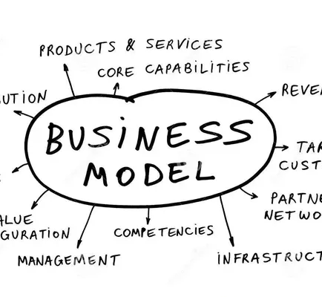
Effective Boards Understand Their Business Model
Board members can clearly articulate how their CU is unique and what makes their business model work.
They know specifically whom they serve, which products to offer to meet member’s unique needs.
They understand risk management and pricing.
They have well thought out strategic plans.

Slide 22
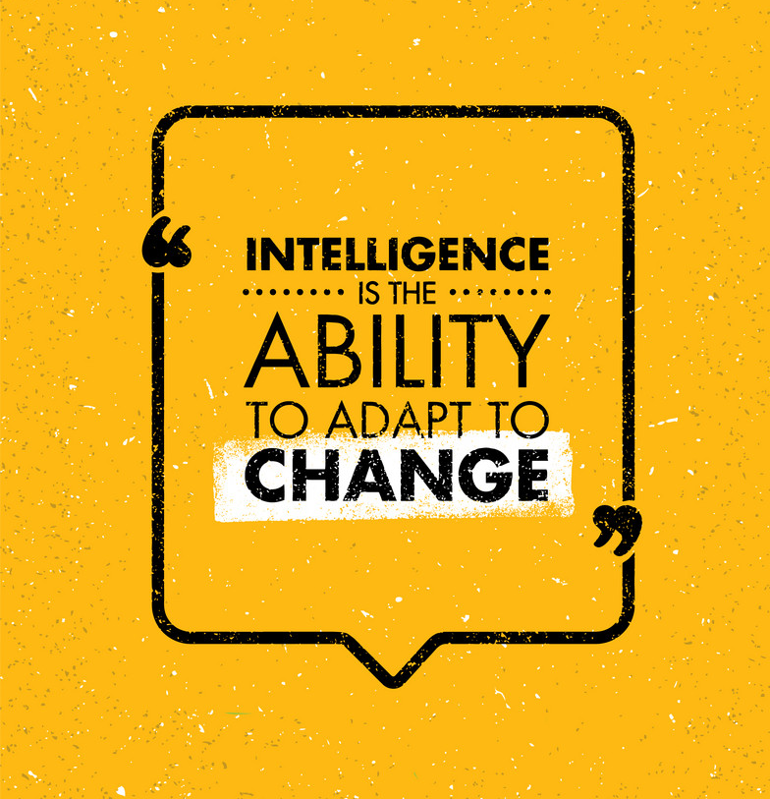
Effective Boards Adapt and Change
Successful boards consistently adapt to change. They seek continuous education and learning.
Very few “sacred cows” in these shops.
Management isn’t governed by “this is the way we have always done it.”
The board’s ability to adapt and embrace change sets the tone for management and all staff, which leads to a culture of innovation and growth.
What is a recent example of how the board has adapted or changed?

Slide 23
Important take aways
Your credit union must have a compelling purpose
Seek people that find your purpose compelling, share your values and want to make a difference
Seek people from the demographic groups that you want to attract and grow
Engage, develop and recognize

Slide 25
Scott@YourCUPartner.org

