Slide 1
NCUA Update
Cherie Freed, Regional Director
Western Region
January 18, 2024
The views and opinions expressed are those of the presenter and do not reflect the official views of, nor should be considered an endorsement by, the National Credit Union Administration’s Board of Directors, its management or staff.

Slide 2
Credit Union Total Assets

Slide 3
More Members - Fewer Credit Unions

Slide 4
Net Worth

Slide 5
Return on Average Assets

Slide 6
Emerging Risks?
Credit Risk
Liquidity Risk
Operational Risk
Fraud Risk
Cyber Security
Human Capital

Slide 7
What Keeps the RD Up at Night?
January 2024
RE/Commercial Uncertainty
Short Memories
Fraud (Internal / External)
Cyber Security
Auto Lending
NIM (Chasing Yields)
Too Much of a Good Thing
Single Concentrations
Long-Term Negative Earnings
November 2019
Hijacking
Short Memories
Single Concentrations
Long-Term Negative Earnings
Fraud (Internal / External)
Cyber Security

Slide 8
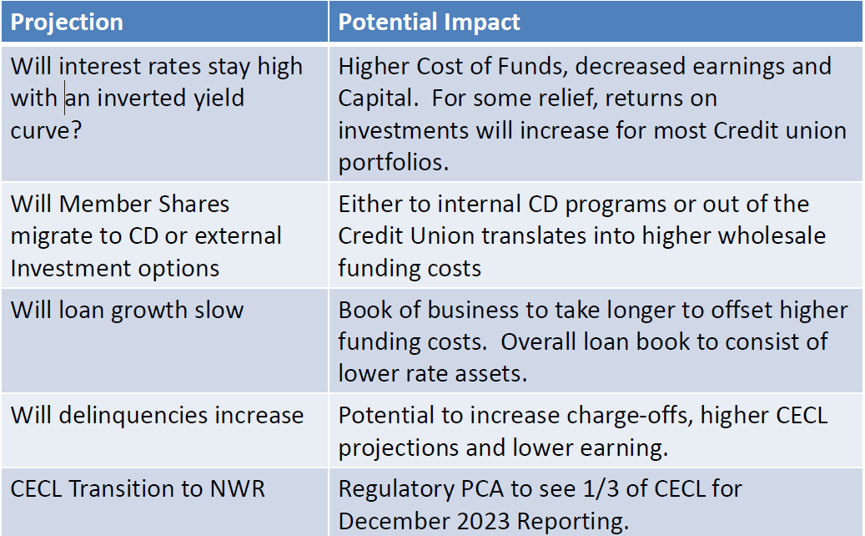
Uncertainty and Headwinds

Slide 9
Managing Liquidity Risk
Contingent Funding Plans (CFPs) are king!
Credit unions should justify their assumptions given the current market volatility and uncertainty – not examiners
Assessment of borrowing lines and contingent liquidity facilities in changing financial conditions
Cashflow forecasting using risk-based scenarios including, at a minimum high-for-long interest rate scenarios
Generally speaking
Liquidity risks are clearly elevated
Deposit flight risk is a real thing
Deposit retention can be costly when using CD specials
Borrowings can be your friend (defense and duration offset)
Watch for the evolving credit deterioration

Slide 10
Credit Risk
Credit Risk Management & Mitigation:
Loan program adjustments since COVID-19
Loan workouts and accommodations
Controls, reporting, tracking activity
Collection procedures and staffing
Ongoing continued prudent efforts

Slide 11
Cyber Threats
Cyber Thieves
Target: Any Institutions
Tactic: Attack Individual Systems
Objective: Steal Money
Cyber Terrorists
Target: Vulnerable Entry Points (All Credit Unions)
Tactic: Infiltrate Interconnected Systems
Objective: Cripple or Destroy the U.S. Economy

Slide 12
Cyber Security – What Can You Do?
Ensure your CU systems are secure.
Implement risk mitigation controls: vendor due diligence, strong password policies, proper patch management, employee training, and network monitoring.
Get educated.
Share cyber security best practices.
Participate in local, state and national information-sharing forums.

Slide 13
Operational Risks – Fraud Hot Spots
Poor Accounting Controls/Un-reconciled Books
Ensure clean timely records and effectively monitor financial activity
Fictitious and Fraudulent Loans or Cash
Monitor new loans, charged off loans, due dates, subsidiary vs control account
Reconcilements of vault cash
Un-cleared Overdrafts
Ensure timely bank reconcilements, review general ledger, access controls and override reports
Dormant/inactive share accounts
Monitor and clear inactive accounts
Control reports
Unrecorded shares
Segregate activity and limit access control
Monitor bank activity
False Expenditures
Unsupported expenditures
Budget/financial statement monitoring

Slide 14
Best Practices
Best practices:
Establish sound policies, procedures, and processes that are accessible and followed by staff
Train staff about fraud risks unique to their position
Have an active supervisory committee that completes all requirements in accordance with regulations
Cultivate a culture that encourages reporting
Conduct fraud risk assessments, internal audits, and reviews after problems are identified

Slide 15
Other Topics
CECL
BSA/AML
Consumer Financial Protection

Slide 16
Questions

Slide 17
Office Contact Page
Feel free to contact our office with questions or comments.
Primary Staff: Cherie L. Freed
Western Regional Director
cfreed@ncua.gov
Office Phone: 602-302-6000

