Slide 1
Advocacy in the 118th Congress & with Regulators
Jason Stverak – Deputy Chief Advocacy Officer for Federal Government Affairs

Slide 2
The Lay of the Land in Congress
Government funding legislation – January 19 & February 2
National Defense Authorization Act – December 31
Israel/Border/Ukraine Supplemental – no date
CRA deadline – June/July
These can be opportunities and/or threats for policy riders

Slide 3
The Lay of the Land in Financial Services
Digital Assets – Stablecoin and Market Structure
SCOTUS decision on the CFPB
RECOUP Act
SAFE(R) Banking
Interchange

Slide 4
The Lay of the Land for Credit Union Legislation
Credit Union Board Modernization
CDFI Testimony
Veterans Member Business Lending
Loan Maturities
CDFI Decertification Process and Ombudsman

Slide 5
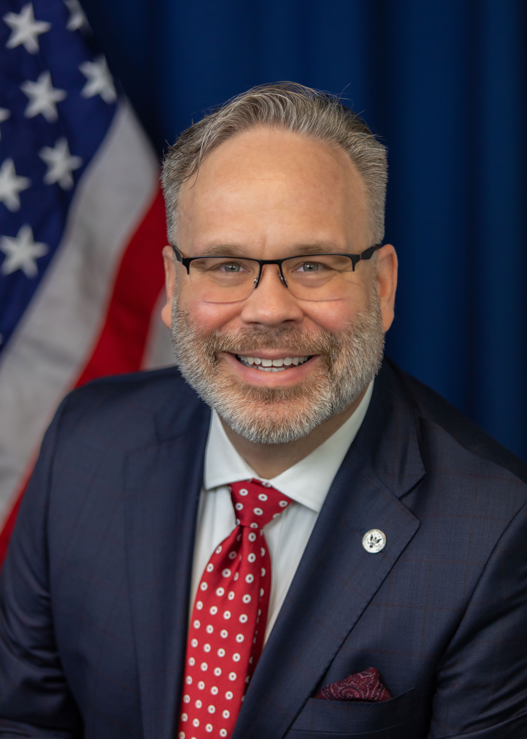
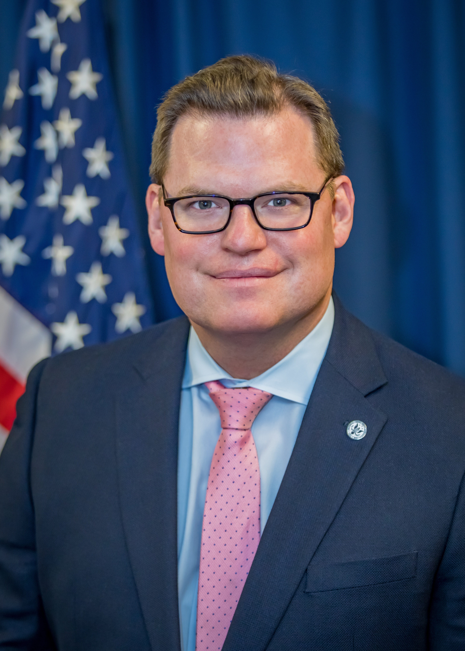
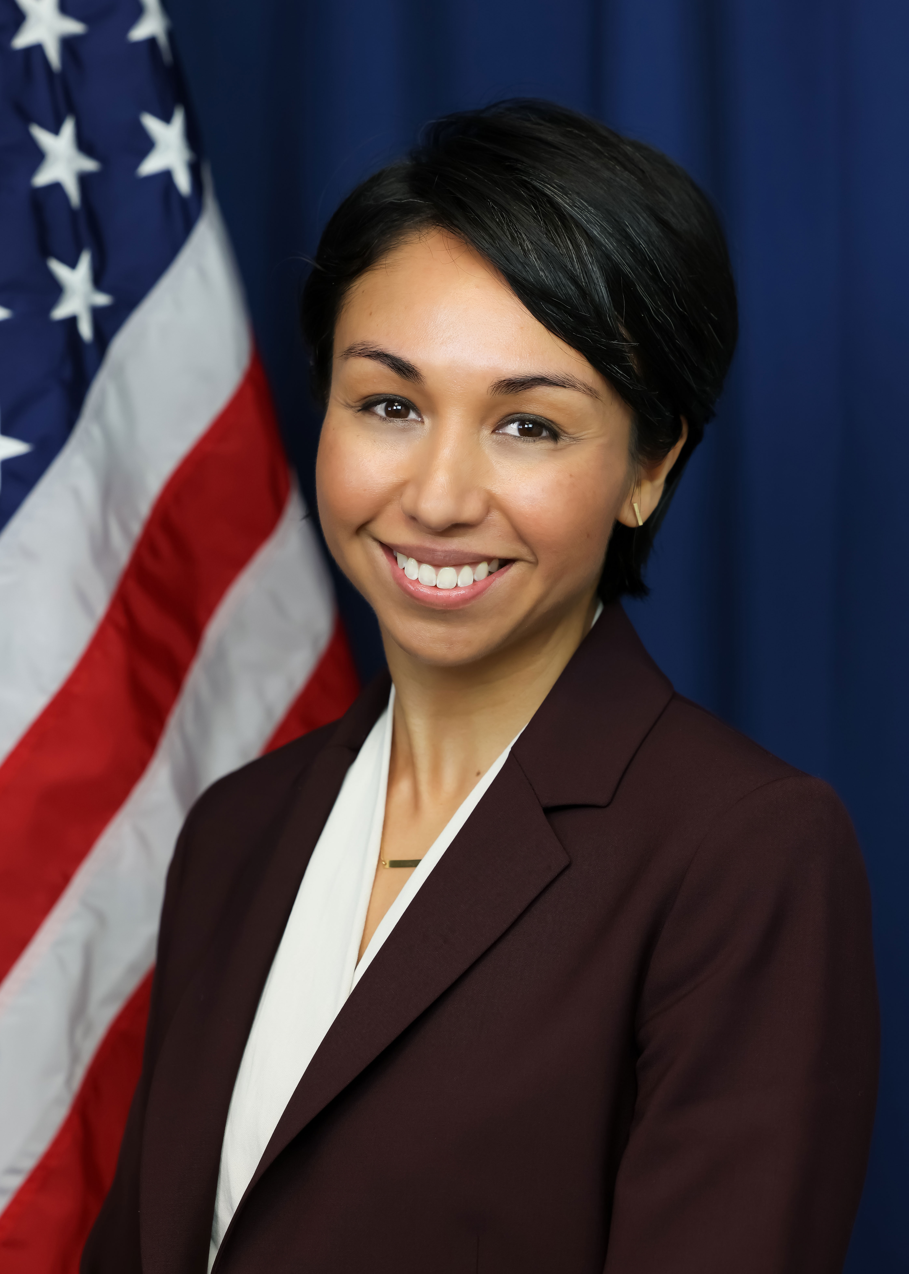
National Credit Union Administration
Chairman Harper: focused on cybersecurity, vendor authority, consumer protection, and climate change
Vice Chairman Hauptman: focused on innovation and digital assets, improving de novo chartering, and serving the underserved
Board Member Ostuka: focused on ensuring smaller CUs remain competitive and can enahnce access in underserved areas

Slide 6
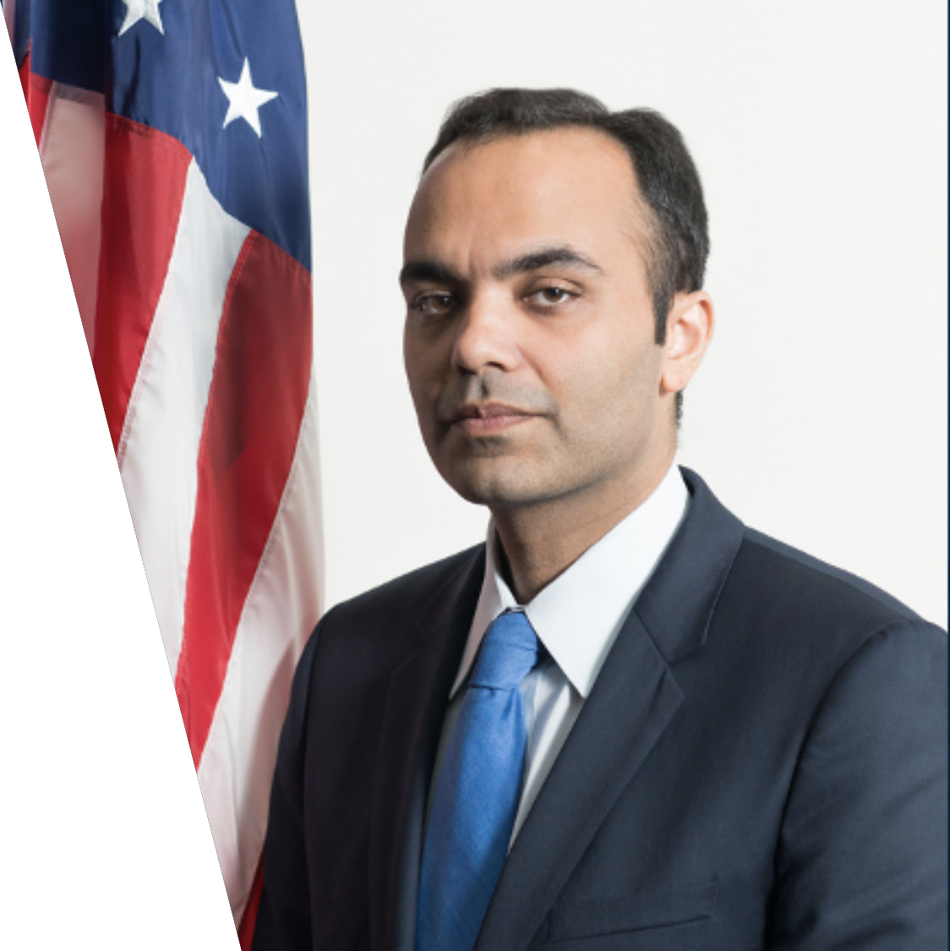
Consumer Financial Protection Bureau
Director Rohit Chopra, former FTC Commissioner, prefers to rely on supervisory guidance, advisory opinions, and blogs to issue policy directives
CFPB Director is subject to removal by the president – 2024 election may change things
CFPB to issue proposals on overdraft and NSF soon. Also anticipating final rule on credit card late fees
Other future rulemakings: Section 1033 open banking final rule, nonbank payment providers as "larger participants" final rule

Slide 7
Federal Reserve
Interchange fee cap is currently set at 21 cents plus a 5 basis point ad valorem component (multiplied by the value of the transaction), plus a 1.0 cent fraud-prevention adjustment, if eligible
The 21-cent base component must be “reasonable and proportional” to issuer costs
Regulatory:
Merchants petitioned the Fed to lower the interchange cap, arguing that the Durbin Amendment and its Reg II rule require it to reevaluate the costs to issuers and potentially reset the interchange fee cap
In October, the Board proposed amendments to Reg II to adjust the interchange fee cap: (1) Base component decreased to 14.4 cents and (2) ad valorem component decreased from 5 basis points to 4 basis points, but (3) the fraud-prevention adjustment increased from 1.0 cents to 1.3 cents
Cap would automatically adjust every other year based on data from the Board's biennial survey of large debit card issuers
Legal:
The Supreme Court granted review in Corner Post, Inc. v. Bd. of Governors of Fed. Rsrv. Sys. to consider whether the challenge to the Reg II rulemaking exceeded the 6-year statute of limitations in the Administrative Procedure Act

