Slide 2
Purposely pivot and prosper
Facilitated by: Scott Butterfield

Slide 4
A Point of Strategic Inflection

Slide 5
Strategic Considerations
Succession and HR – How will we recruit, develop, and retain the right people.
Consumer demographic shifts – What will consumers need, want and expect?
Scale – How much must we grow to remain profitable and relevant?
Technology – How will next generation change the way we do business?
Niche – which group can we compete for and win?

Slide 6
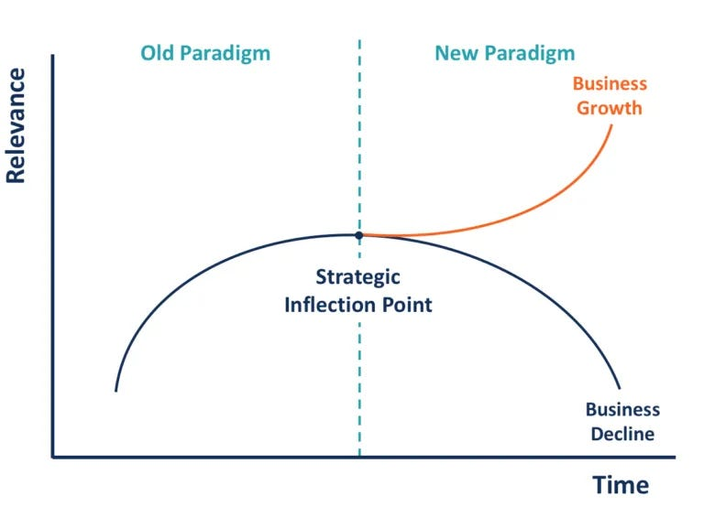
How will you respond?
A strategic inflection point is a time period when an organization must respond to disruptive change in the business environment effectively or face deterioration.

Slide 7
Purposefully Pivot

Slide 8
5 Arguments for a CU Pivot
What consumers need, want and expect has dramatically changed. Product benefit, features and delivery need to change to reflect.
Business model challenges: Rising cost of technology, human resources, competition require consistent profitable growth. CU must find new and higher sources of revenue.
Competitors pose a significant threat to organic member, loan and deposit growth. Must find a niche market CU can compete in.
Strategic alignment when the mission, vision, values and brand have lost their meaning and are no longer relevant in the current group/community they serve. Purpose must realign or find a new group that will respond to current proposition.
Leadership isn’t prepared for succession and/or lack the expertise (and will) to adapt to big changes. Ramp up development, make key personnel changes, increase accountability.

Slide 9
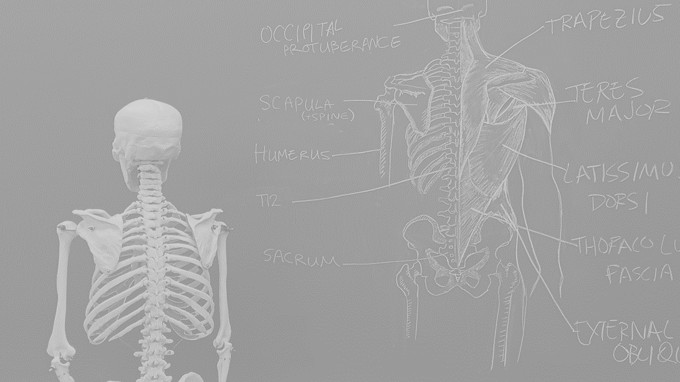
Anatomy of a perfect pivot
The Member Credit Union Story

Slide 10
Background for the Pivot
From 2012 to 2016 – membership growth was negative. In 2016, the year they committed to the big pivot, their net worth ratio was at 6.94%, net membership was negative -21.74%, ROAA was 0.41% and assets were $28.7 million.
Educator Sponsor – Affluent Greenwich, CT
Decreased sponsor advocacy
Sponsor size shrinking and aging membership
Decreasing need for consumer loans
Competing head-to-head for prime consumers
CU was $25 million assets – limited capacity
Older sponsor based board of directors
CU long term trend of negative member growth, thin margins, and mediocre loan growth

Slide 11
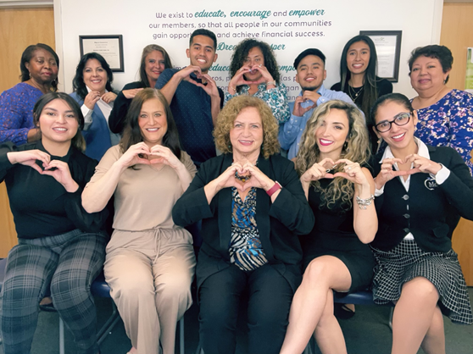
The Pivot
Honest reflection about sustainability
High commitment – leadership didn’t want CU to go away. Willing to work hard to reinvent
Broad search for a Sponsor/community/group that still needed a credit union.
Research, due diligence – Identified Stamford, CT – working class, Hispanic and immigrant community
2016 Business plan
Reimaging purpose, mission, vision and values
Rework product features, underwriting
Financial educators
Lending – ITIN, risk-based lending
DEI –
Translations
Community partnerships
Intentional marketing in new community.
Board recruitment & leadership development

Slide 12
Relevance and Results
Today, MCU excels at:
Bilingual/translation
Risk based and ITIN lending
Financial education 100% FICEP
Board and staff diversity
Community outreach with top nonprofits
Non – Citizen support and lending
Membership giveback
Succession development
Grant awards
Member Testimonial – “I came to this country in 2009 without knowing the Economic System.
It was not until 2014 that I met MCU, only with the intention of saving and not paying bank account maintenance fees. But I received much more than that, they received me with kindness, and gave me the opportunity to pay off my debts, being able to have our first new car.”

Slide 13
Credit union is PROSPERING again!

Slide 14
Important take aways
Define a compelling purpose
Take a broad look around
Make honest assessments
Reach for long-term, sustainable solutions rather than quick-fixes

Slide 16
scott@yourcupartner.org

